Slide 1
AI Modelling for Drug Analysis and Predictions
Rishi Senthil Kumar – 21BLC1045 Jagadeshwar Muthukumaran – 21BLC1277 Ashwin Sivakumar – 21BLC1296
Guide: Dr. Reena Monica P

Slide 2
Outline
Section Name | Slide Number
Introduction | 3
Problem Statement | 4
Research Objective | 5
Proposed System | 6-12
i. Proposed System Introduction | 6
ii. Proposed System Diagram | 7
iii. List of Modules | 8
iv. Modules Explanation | 9-12
Implementation and Results | 13-21
Conclusion and Future Work | 22
Guide Approval mail snapshot | 23
Research Paper Status | 24
References | 25
Poster | 26

Slide 3
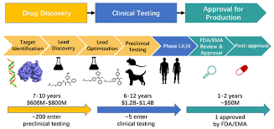
Introduction
The lengthy and costly nature of drug discovery and analysis in the pharmaceutical industry, particularly during experimental phases, underscores the need for more efficient methods.
Cheminformatics, combined with AI-driven techniques, is essential for efficiently screening drug targets and simulating drug candidates, significantly reducing both time and expenses.

Slide 4

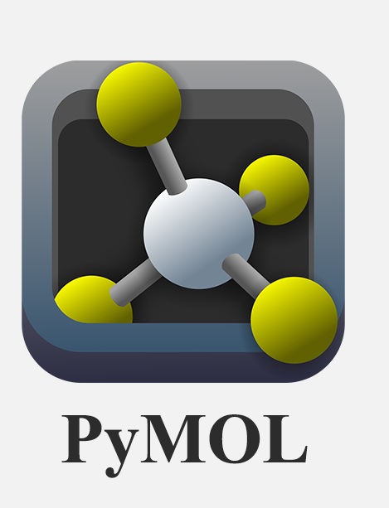
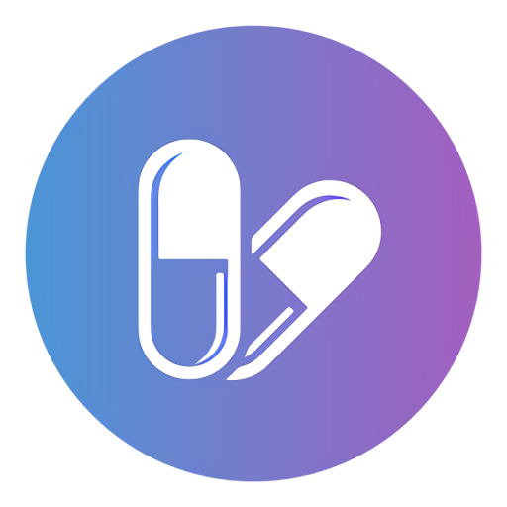

Problem Statement
Current computational tools like AutoDock Vina, PyMOL, ADMET Lab, and SwissDrugDesign require coding knowledge, making them inaccessible to many researchers. Additionally, traditional simulation methods are resource-intensive and time-consuming. The lack of an integrated, no-code solution forces users to rely on multiple platforms for a single analysis. Our goal is to address these issues by providing an automated, AI-assisted framework that simplifies drug discovery workflows.

Slide 5
Research Objective
The goal is to develop an application for a researcher in the field of drug discovery. We intend to create a framework to order to perform the following tasks:
Develop a user-friendly web application for drug discovery and predictive modeling.
Integrate ML models for ADME analysis, binding affinity prediction, and drug synergy analysis.
Implement AI-assisted inference for contextualized predictions.
Enable no-code interaction, allowing researchers to run complex models effortlessly.

Slide 6
Proposed System Overview
Our DrugXplorer framework is designed to streamline drug discovery through an AI-powered, no-code platform. The system takes Drug Name/SMILES and Target Property as inputs to perform Drug Property Analysis, which includes:
ADME Analysis – Evaluates absorption, distribution, metabolism, and excretion properties.
Binding Affinity Prediction – Predicts interactions between drugs and target proteins.
Drug Synergy Prediction – Analyzes the combined effect of drug pairs.
The Predicted Output is then processed by a Multi-Agent AI Model, which integrates a Large Language Model (LLM) for generating a Detailed Inference. This inference provides contextual insights and validation, aiding researchers in decision-making.
Our approach ensures an automated, accessible, and AI-enhanced workflow for drug discovery, reducing dependency on complex coding tools while improving prediction accuracy.

Slide 7
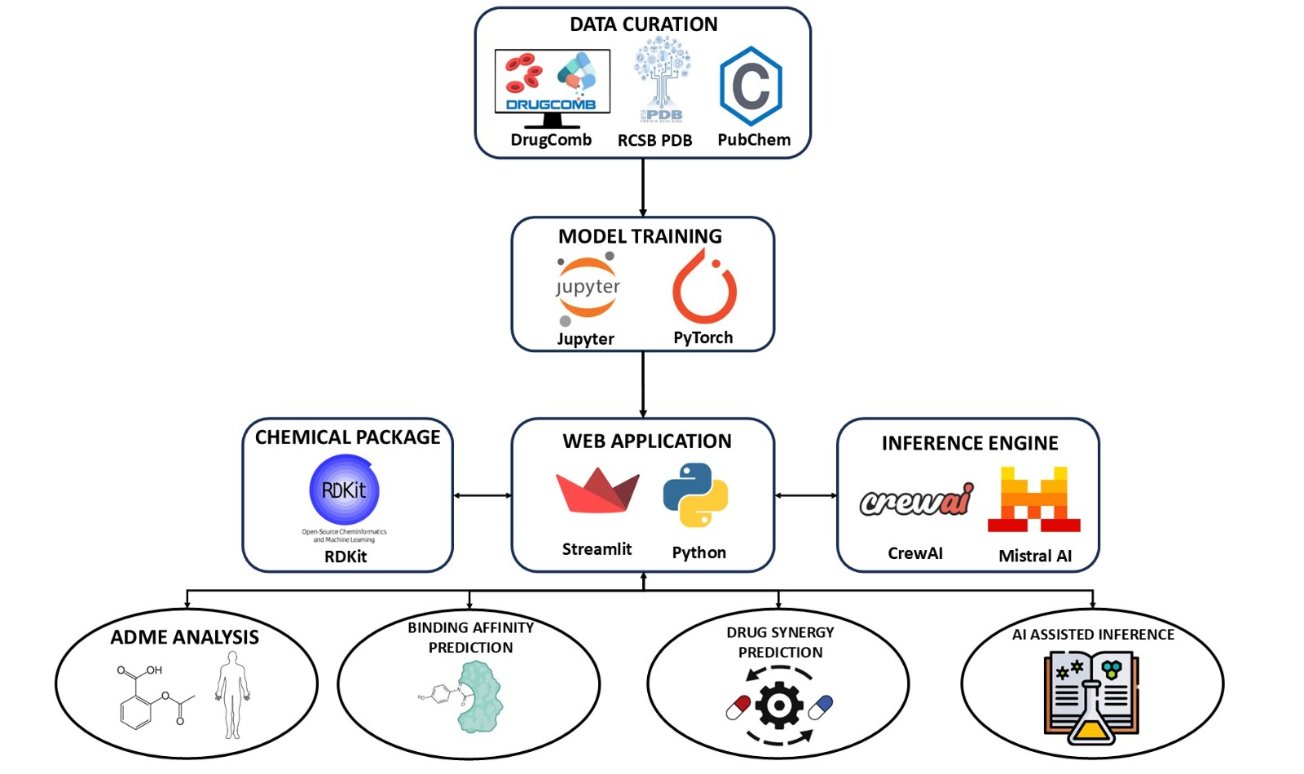
Proposed System Diagram

Slide 8
List of Modules
SMILES (Simplified Molecular Input Line Entry System)
Morgan Fingerprinting
PyTorch
CrewAI
Streamlit

Slide 9
SMILES & Morgan Fingerprinting
SMILES (Simplified Molecular Input Line Entry System)
A text-based representation of molecular structures.
Used in cheminformatics for drug property prediction and database searches.
Morgan Fingerprinting
Converts SMILES into a fixed-length binary vector representation.
Each bit represents the presence (1) or absence (0) of molecular substructures.
Used for binding affinity and drug synergy prediction.
Generated using RDKit with a 150-bit fingerprint (radius = 6) for single drugs, and a 300-bit concatenated fingerprint for synergy analysis.

Slide 10
PyTorch for Classification & Regression
Classification (Feed-Forward Neural Network)
Binary classification (Active = 1, Inactive = 0).
Input: 150-bit fingerprint, Architecture: 4 hidden layers (1024 → 512 → 256 → 128).
Training: 100 epochs, Optimizer: Adam, Loss Function: CrossEntropyLoss.
Regression (Convolutional Neural Network)
Input: 150-bit for binding affinity, 300-bit for synergy.
Architecture: 2 Convolutional layers (kernel size = 3), Pooling layer (kernel size = 2).
Regularization: Dropout (30%) to prevent overfitting.
Training: 1000 epochs, Early Stopping enabled.

Slide 11
Crew AI for Inference Assistance
CrewAI Integration for Contextual Analysis
Extends ML model predictions with AI-driven insights.
Uses Multi-Agent AI System to process outputs from affinity, synergy, and ADME models.
Large Language Model (LLM) + AI Agents generate detailed explanations.
Enhances decision-making for researchers by providing interpretability & recommendations.

Slide 12
Streamlit
Streamlit is used to develop the web application for drug discovery.
It provides an interactive interface for ADME profiling, binding affinity, and drug synergy analysis.
The module integrates RDKit, PyTorch, and crewAI for real-time predictions.
It enables easy result visualization without requiring programming expertise.

Slide 13
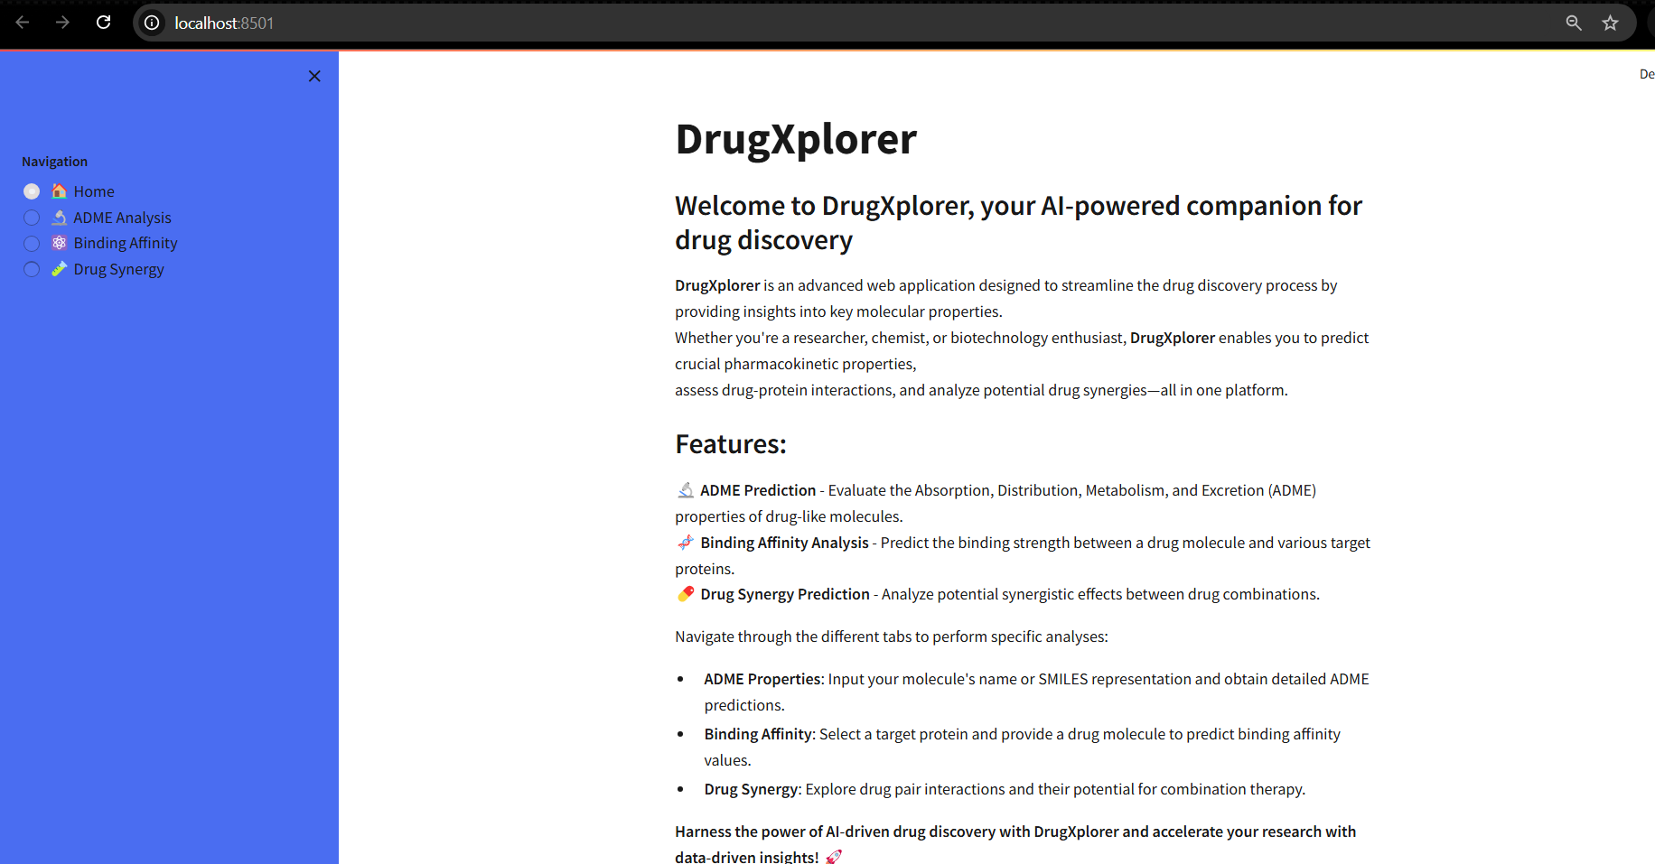
Web Application Home page
The Home page of DrugXplorer provides a brief introduction to the three main sections of our application: ADME analysis, binding affinity prediction, and drug synergy prediction.

Slide 14
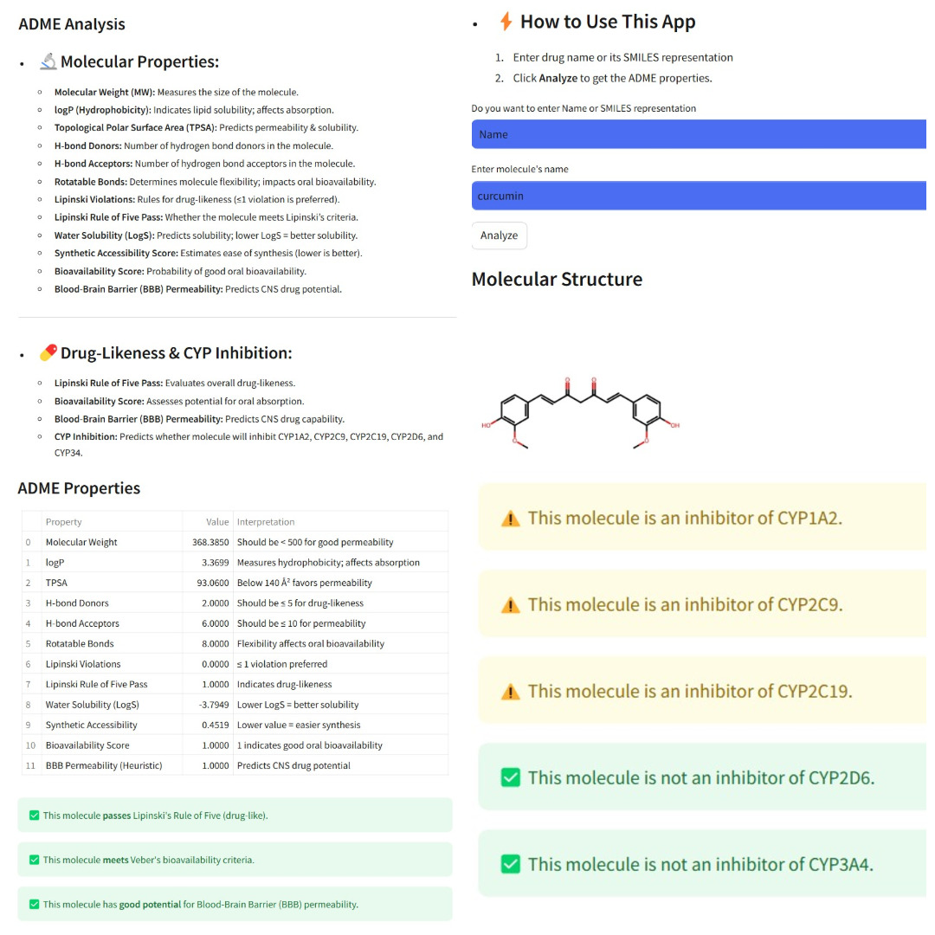
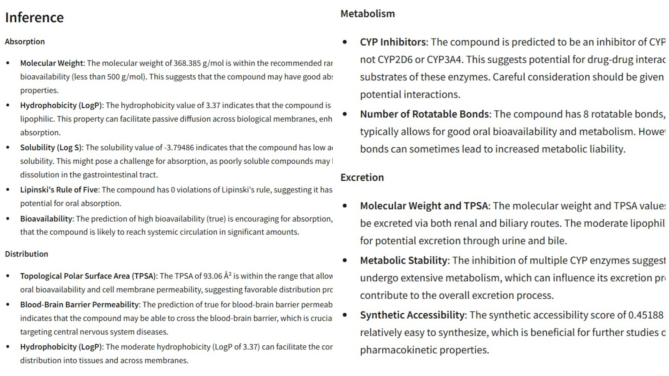
Web Application ADME Analysis
The ADME analysis presents key molecular properties of a compound in a table, including molecular weight, hydrophobicity, TPSA, hydrogen bond donors and acceptors, rotatable bonds, Lipinski violations, water solubility, bioavailability, and BBB permeability, all computed using RDKit. These properties help evaluate the compound’s oral bioavailability, BBB permeability, and potential for drug-drug interactions. Classification models further predict the inhibition of major CYP enzymes (CYP1A2, CYP2C9, CYP2C19, CYP2D6, and CYP3A4). An inference is then generated, providing insights into the compound's ADME characteristics.

Slide 15
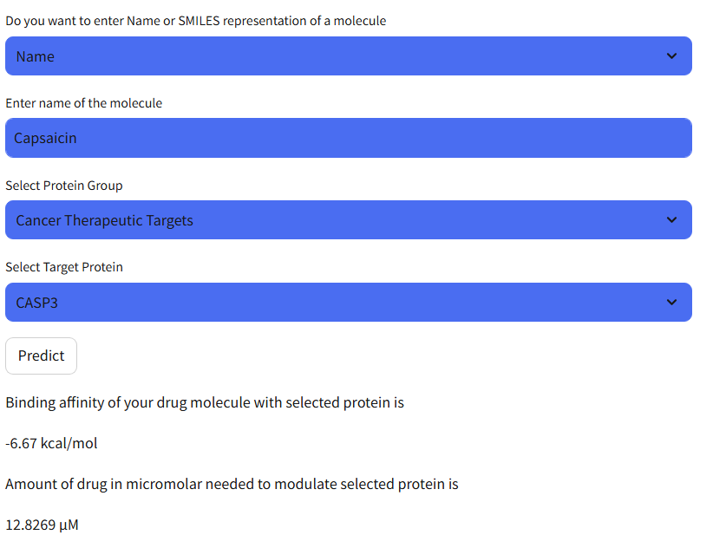
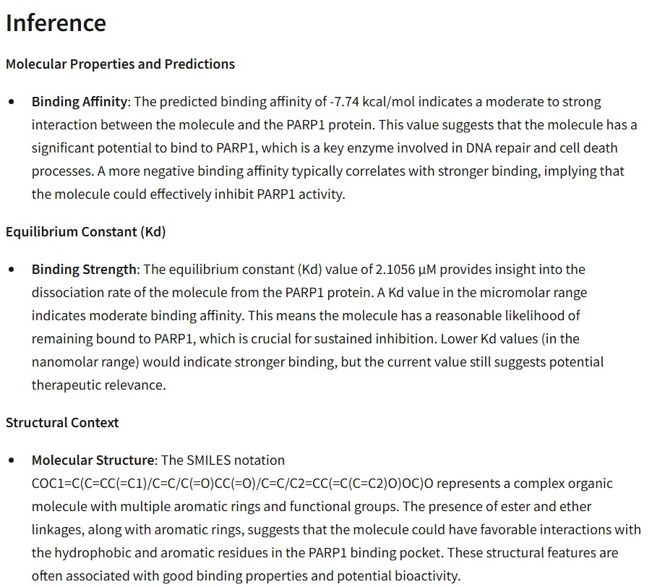
Web Application Binding Affinity
Once a compound and target protein are input, the model predicts the binding affinity and the required dosage to modulate the protein. An inference is then generated, analyzing key molecular properties such as binding affinity, equilibrium constant, and structural context. These properties reflect the strength and stability of the compound-target interaction and the potential for favorable binding. This information provides insight into the therapeutic potential of the compound and can aid researchers in prioritizing it for further development and testing.

Slide 16
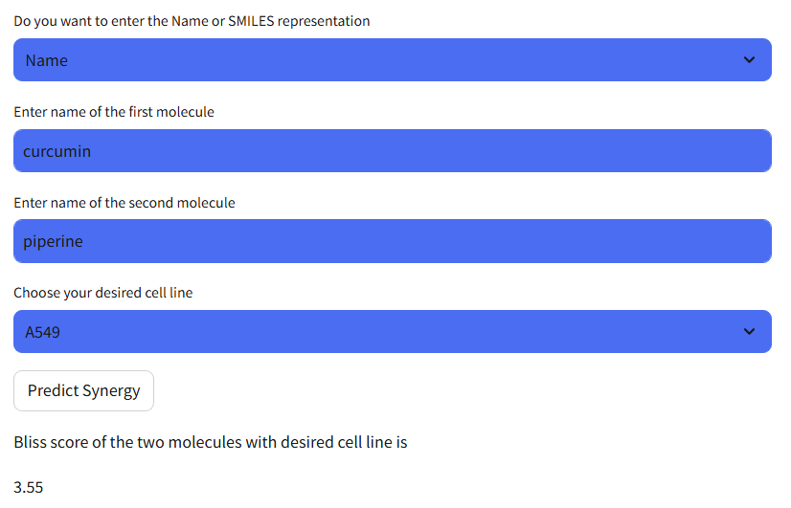
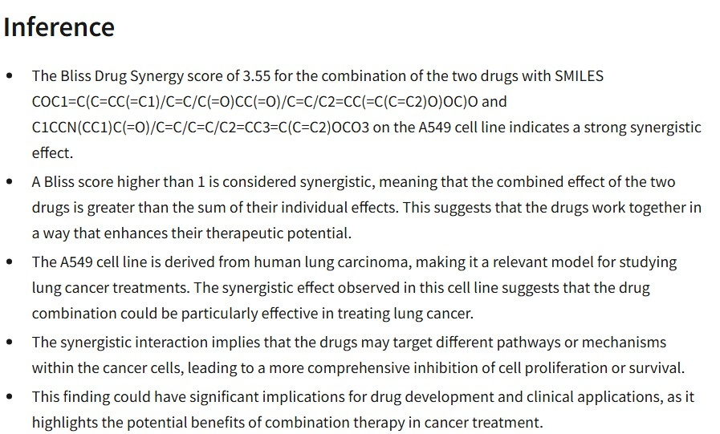
Web Application Drug Synergy
Once two compounds and a target cell line have been given as input, the Bliss synergy score is predicted. The score categorizes the drug interaction as synergistic (>1), additive (between -1 and 1), or antagonistic (<-1). This inference provides insights into the effectiveness of the drug combination on the given cell line, along with its origin and relevance to cancer treatments. Overall, it highlights the potential of combination therapies and their implications for clinical applications and drug development.

Slide 17
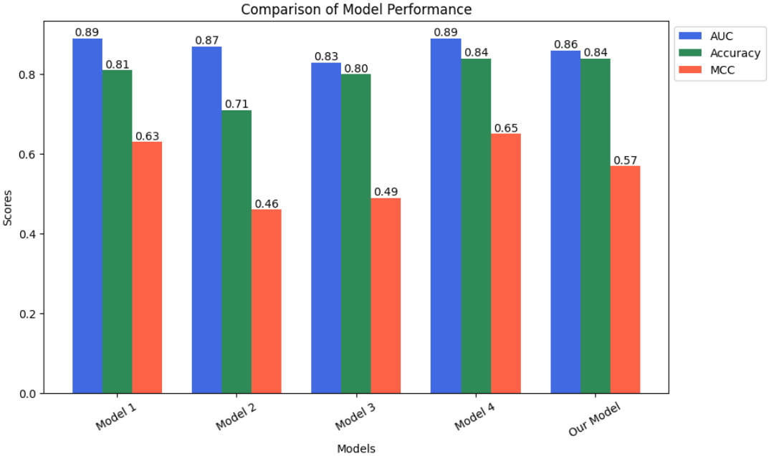
CYP Classification Model Performance
The Bar Chart presents a comparison of the average AUC, accuracy, and MCC across all five datasets against the benchmark models, highlighting our model’s strong predictive capability for CYP inhibition.

Slide 18
Classification Model Performance Evaluation Metrics
Accuracy = (TP + TN) / (TP + TN + FP + FN)
MCC = [(TP × TN) − (FP × FN)] / √[(TP + FP)(TP + FN)(TN + FP)(TN + FN)]
AUC = Σ [(xᵢ₊₁ − xᵢ) × (yᵢ + yᵢ₊₁) / 2]
Where:
xᵢ = FP / (FP + TN)
yᵢ = TP / (TP + FN)
MCC = Matthews Correlation Coefficient
AUC = Area Under the Curve
TP = True Positives
TN = True Negatives
FP = False Positives
FN = False Negatives

Slide 19
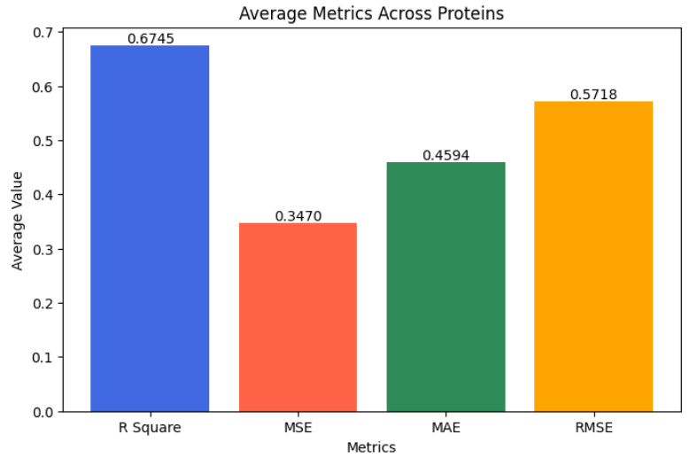
Binding Affinity Regression Model Performance
The bar chart displays the average performance metrics of a drug synergy prediction model across 8 cell lines. The model achieves a good R² value of 0.6745, indicating it explains about 67% of the variance in the data. The error metrics—MSE (0.3470), MAE (0.4594), and RMSE (0.5718)—are relatively low, suggesting the model makes accurate predictions with minimal deviation from actual values. Overall, the results reflect strong and consistent model performance across different proteins.

Slide 20
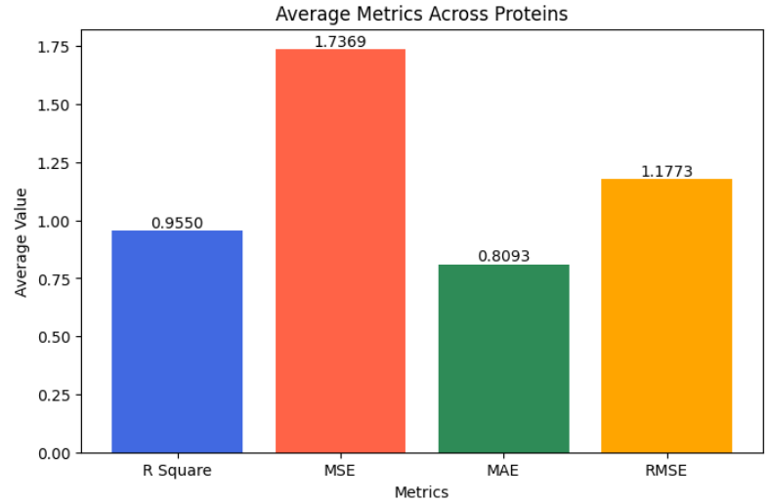
Drug Synergy Regression Model Performance
The bar chart presents the average performance metrics computed across 24 proteins. The R² score has an average value of 0.9550, indicating that the model explains approximately 95.5% of the variance in the observed data. The Mean Squared Error (MSE) averages 1.7369, while the Mean Absolute Error (MAE) is 0.8093, and the Root Mean Squared Error (RMSE) is 1.1773. These metrics collectively suggest that the model maintains high predictive accuracy and low error across all 24 proteins evaluated.

Slide 21
Regression Model Performance Evaluation Metrics
R² = 1 − [Σ(yi − ŷi)² / Σ(yi − ȳ)²]
MSE = (1 / n) × Σ(yi − ŷi)²
MAE = (1 / n) × Σ |yi − ŷi|
RMSE = √[(1 / n) × Σ(yi − ŷi)²]
Where:
yi = actual value
ŷi = predicted value
ȳ = mean of actual values
n = number of data points
R² = R-squared
MSE = Mean Squared Error
MAE = Mean Absolute Error
RMSE = Root Mean Squared Error

Slide 22
Conclusion and Future Work
DrugXplorer offers a unified, AI-powered platform that simplifies in-silico drug discovery by integrating ADME prediction, CYP450 inhibition classification, binding affinity estimation, and drug synergy analysis. With a user-friendly Streamlit interface and strong predictive performance across all modules, the platform addresses the inefficiencies of using multiple tools. Its Agentic-AI framework enhances interpretability, making data-driven decisions more accessible, efficient, and cost-effective for researchers.
In future, we aim to improve model accuracy by incorporating advanced architectures such as Quantum Convolutional Neural Networks and expanding the range of protein targets used in binding affinity prediction. These enhancements will increase the platform’s generalizability and robustness, further establishing DrugXplorer as a powerful and scalable tool in computational drug discovery.

Slide 23
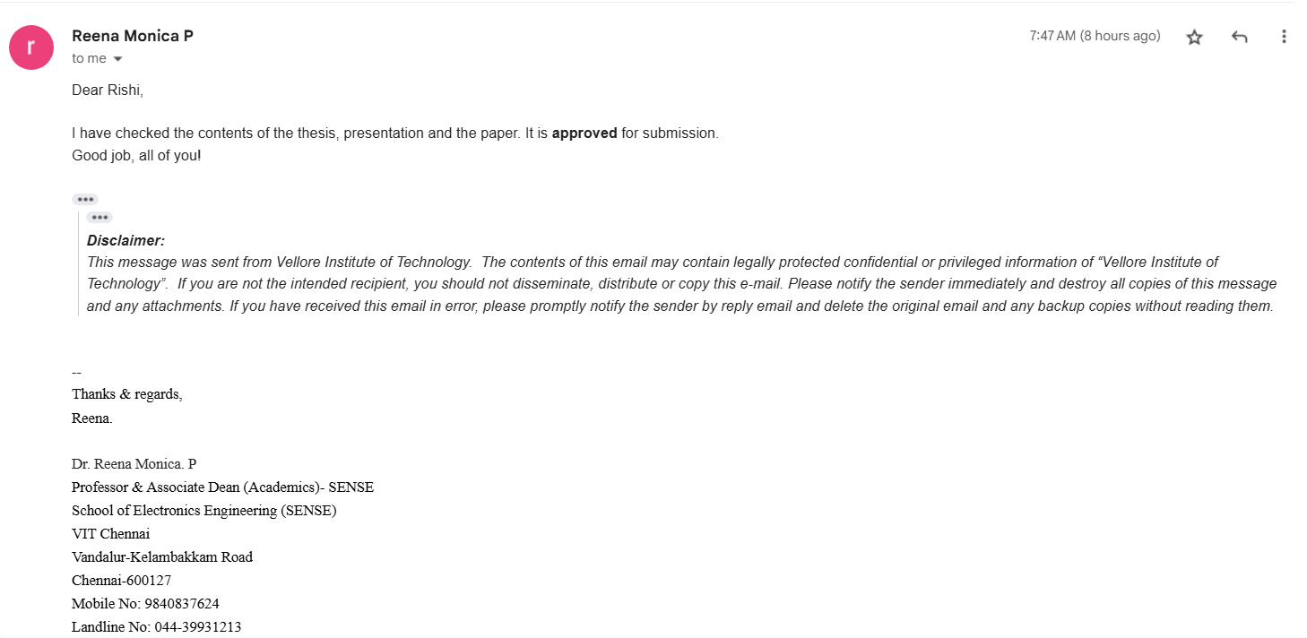
Guide Approval mail snapshot

Slide 24
Research paper status
The manuscript is ready and will be submitted to the Journal of Cheminformatics before the final review.
Journal of Cheminformatics is an open-access journal publishing original peer-reviewed research in all aspects of cheminformatics and molecular modelling.
https://jcheminf.biomedcentral.com/

Slide 25
References
[1] Scannell, J.W., Bosley, J.: When quality beats quantity: Decision theory, drug discovery, and the reproducibility crisis. PLOS ONE 11(2), 1–21 (2016) https://doi.org/10.1371/journal.pone.0147215
[2] Zhang, K., Yang, X., Wang, Y., Yu, Y., Huang, N., Li, G., Li, X., Wu, J.C., Yang, S.: Artificial intelligence in drug development. Nature Medicine 31(1), 45–59 (2025) https://doi.org/10.1038/s41591-024-03434-4
[3] Jamkhande, P.G., Ghante, M.H., Ajgunde, B.R.: Software based approaches for drug designing and development: A systematic review on commonly used software and its applications. Bulletin of Faculty of Pharmacy, Cairo University 55(2), 203–210 (2017) https://doi.org/10.1016/j.bfopcu.2017.10.001
[4] Vamathevan, J., Clark, D., Czodrowski, P., Dunham, I., Ferran, E., Lee, G., Li, B., Madabhushi, A., Shah, P., Spitzer, M., Zhao, S.: Applications of machine learning in drug discovery and development. Nature Reviews Drug Discovery 18(6), 463–477 (2019) https://doi.org/10.1038/s41573-019-0024-5
[5] Eberhardt, J., Santos-Martins, D., Tillack, A.F., Forli, S.: Autodock vina 1.2.0: New docking methods, expanded force field, and python bindings. Journal of Chemical Information and Modeling 61(8), 3891–3898 (2021) https://doi.org/10.1021/acs.jcim.1c00203. PMID:34278794
[6] Trott, O., Olson, A.J.: Autodock vina: Improving the speed and accuracy of docking with a new scoring function, efficient optimization, and multithreading. Journal of Computational Chemistry 31(2), 455–461 (2010) https://onlinelibrary.wiley.com/doi/pdf/10.1002/jcc.21334
[7] Trott, O., Olson, A.J.: Autodock vina: Improving the speed and accuracy of docking with a new scoring function, efficient optimization, and multithreading. Journal of Computational Chemistry 31(2), 455–461 (2010) https://onlinelibrary.wiley.com/doi/pdf/10.1002/jcc.21334
[8] Garc´ıa-Orteg´on, M., Simm, G.N.C., Tripp, A.J., Hern´andez-Lobato, J.M., Bender, A., Bacallado, S.: Dockstring: Easy molecular docking yields better benchmarks for ligand design. Journal of Chemical Information and Modeling 62(15), 3486–3502 (2022) https://doi.org/10.1021/acs.jcim.1c01334. PMID: 35849793
[9] Landrum, G.A., Riniker, S.: Combining ic50 or ki values from different sources is a source of significant noise. Journal of Chemical Information and Modeling 64(5), 1560–1567 (2024) https://doi.org/10.1021/acs.jcim.4c00049
[10] Landrum, G.: RDKit: Open-Source Cheminformatics Software (2023). https://www.rdkit.org

Slide 26
